Slide 1
Cultural Evolution and Multi-Level Selection

Slide 2
The Evolutional Process
„Evolution“ can be regarded as an abstract concept that is independet of ist specific application in a domain:
Definition Attempt: An Evolutional Process operates on a specific set of objects with specific attributes in an iterative process, which can abstractly be defined as a loop that for each (possibly infinitely short) iteration performs the following constant rulesets subsequently:
Mutation: The attributes of a specific subset of the set/population changes due to element or attribute-dependent and/or random mutation rules
Selection: Elements with specific attributes are increased or decreased according due to element or attribute-dependent and/or random selection rules
Mutation
Selection

Slide 3
Example Applications of Evolutional Processes
Application | Objects | Attributes | Mutation Rules | Selection Rules
Biological Evolution | Genes, Living Beings | Physical Attributes | Biological Mutation | „Fitness“
Evolution of Ideas | Ideas, Concepts („Memes“, „Narratives“) | Domain, Content, Virality,… | Adaptation, Simplification, Extension, Application,… | Simplicity, Applicability, Attention
Agile Software Engineering | Implementation (Code, Systems,…) or Solution(s) | Functional and Non-Functional Properties | Rules of Software Engineering | Scope, Quality, Customer Satisfaction
Cultural Evolution | Individuals, Social Groups | Cultural Traits | Modification of Social Traits, Group Dynamics | Cooperation/ Conflict Results

Slide 4
Cultural Evolution and Social Darwinism
Evolution in the domain of Societies has often been oversimplified in the concept of so-called „Social Darwinism“
Social Darwinism is a Scam: It mainly focuses on Hyper-Individualism and Biologism neglecting any Group/Societal Dynamics: „There is no such thing as society – there are individual men and women, and there are families“ – Margaret Thatcher

Slide 5
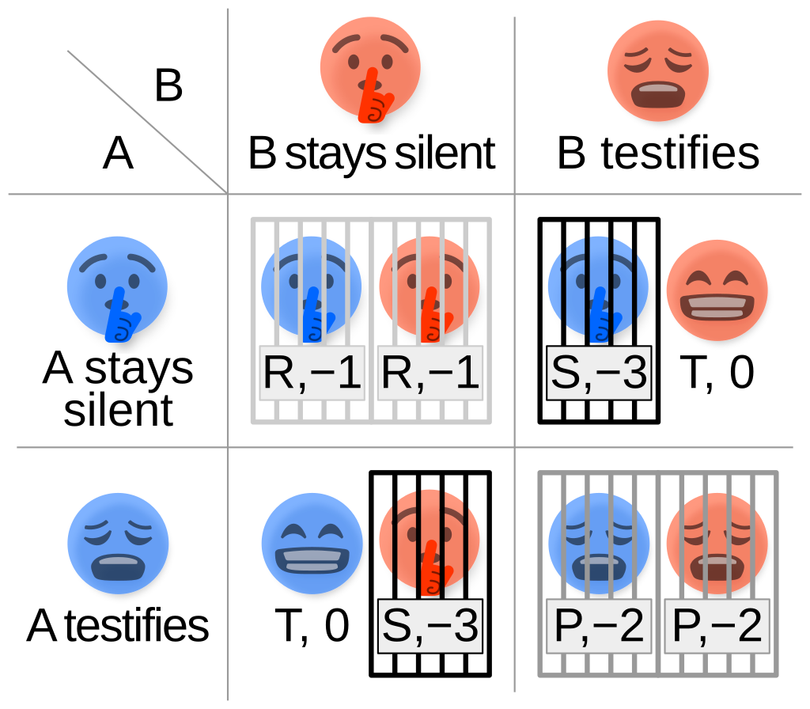
Collective Action Problem and Game Theory
Typical questions that and individualistic Evolutional Theory cannot explain: Where does costly altruistic behavior come from, if the individual does only benefit from other‘s altruistic behavior, but not from its own?
Typical Example in Game Theory: Prisoners Dilemma
Individualistic, rational model says: Betray your comrade to get best score
How can cooperation evolve?

Slide 6
Different Entities - Multilevel Selection
Biological Entities
Organism
Organ System
Organ
Tissue
Cell
Organelle
Social Entities
State Alliances
Federal State
Region
Community
Individual
Ethnic Group
Clan
Family

Slide 7
Basic Model: Cooperators and Defectors
Cooperation
Individuals in a group are either Cooperators or Defectors
Cooperators generate payoff (at a cost), Defectors do not
Payoff is evenly distributed between Cooperators and Defectors
Learning and Mutation
Individuals with little accumulated payoff can „learn“ from Individuals with high payoff and assume their role E.g. a Cooperator with low payoff can assume the role of a Defector, when „learning“ from a Defector with high accumulated payoff
„Mutation“ is random switching roles of some individuals

Slide 8
Single Group Dynamics
Cooperators generate payoff (at a cost) due to their ability to cooperate, Defectors do not
Payoff is evenly distributed among Cooperators and Defectors
Learning results in more and more Cooperators imitating Defectors, because they have a higher accumulated payoff
Therefore the group stabilizes at a high percentage of Defectors, only occasionally creating Cooperators through mutation

Slide 9
Introducing Group Selection
Groups compete with each other
Groups with high amount of cooperators win over those with low amount of cooperation
Resolution: Losing group takes over role distribution of winning group (modelling either replacement or assimilation of losing group)
As a result, Selection is a mixture of „learning“ and „competition“
On individual level it favours Defectors
On group level it favours groups with high number of Cooperators
→ Which selection dominates depends on the weight ratio of the two mechanism

Slide 10
Multilevel Group Dynamics

Slide 11

Enter Punishers
Punisher is a role that cooperates (although with less generated payoff then a Cooperator)
Durin „punishment“ phases, each Punisher decreases the accumulated payoff of a Defector
Punishment costs the punisher a bit, but it costs the Defector much more
The more Defectors are in a group, the less likely a Punisher is about to change his role by „learning“

Slide 12
Single Group Dynamics with Punishers

Slide 13
Multilevel Group Dynamics with Punishers

Slide 14
Backup
Prompt: „In his book "Ultrasociety" Peter Turchin writes about Cultural Evolution with Multilevel Selection that A cooperative trait will evolve (increase in frequency) if: ("Between-Group Variance" / "In-between Variance") > ("Selection Strength on Individuals" / "Selection Strength on Groups"). He calls this formula a "main insight from the price equation". I would like to understand this formula and how it individual variables can be calculated within a mathematical framework describing Cultural Evolution with Multi-Level Selection. Can you help me here?”

